Slide 1
AUTOMATIC SPEEDBREAKER SYSTEM
Presented by:
Srivathsan S
Vasantha Ruban N

Slide 2
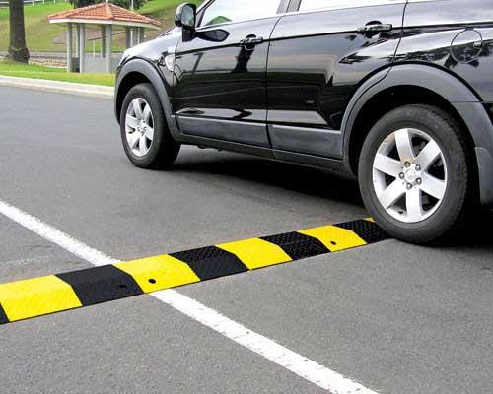
The automatic speed breaker system is a project aimed at saving up the time taken by emergency vehicles on roads.
It consists of a sensor-based mechanism that detects the speed of the approaching vehicle and automatically turns the speed breaker from angle of 0 to 180 degree.
The system operates in manual, automatic, and emergency modes, offering increased road safety and improved traffic management.
Its implementation can have a significant impact on road safety and traffic management, leading to safer and more efficient roads for drivers and pedestrians.
OVERVIEW

Slide 3

The objective of the above is to provide a brief overview of the automatic speed breaker system project. It aims to inform about the purpose, components, and modes of operation of the system, as well as its potential benefits in terms of road safety and traffic management. It aims to convey the importance of the project in reducing time taken by emergency vehicles on roads and highlight the potential positive impact of its implementation.
OBJECTIVE

Slide 4
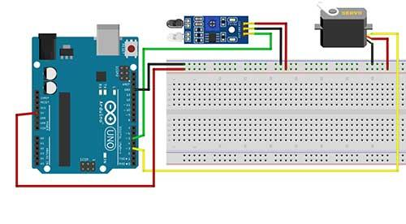
COMPONENTS USED
IR SENSORS
ARDUINO UNO BOARD
SERVO MOTOR
The automatic speed breaker system requires several components to function properly, including
speed sensors, microcontrollers, and motor drivers.
The speed sensors are used to detect the speed of the approaching vehicle, while the microcontrollers process this information and send signals to the motor drivers, which control the speed breaker's height adjustment mechanism. Additionally, the system may require switches or remote controls for manual operation, as well as power sources such as batteries or AC adapters. Other necessary components may include wires, connectors, and mounting hardware to install and connect the system to the road surface

Slide 5
Working
In an emergency situation, time is of the essence, and emergency vehicles such as ambulances, fire trucks, and police cars require quick and safe passage through roads to reach their destination. To facilitate this, the automatic speed breaker system can be designed to recognize emergency vehicles and temporarily lower the speed breaker's height, allowing them to pass safely and smoothly. This can be achieved by incorporating special sensors or GPS systems into the emergency vehicles that communicate with the speed breaker system. When an emergency vehicle approaches, the sensors or GPS system sends a signal to the speed breaker system, causing it to lower the speed breaker's height or even deactivate it temporarily, allowing the vehicle to pass over smoothly. This feature not only ensures that emergency vehicles can reach their destination quickly but also reduces the risk of accidents caused by other vehicles trying to make way for them. Overall, incorporating this emergency vehicle recognition feature into the automatic speed breaker system can significantly improve the efficiency and safety of emergency services

Slide 6

Attention areas
RISk 1
TECHNICAL GLITCHES
RISK 2
CYBERSECURITY THREATS
RISK 3
MAINTENANCE
RISK 4
COST AND FEASIBILITY

Slide 7

Next steps
Integration with other smart traffic management systems
Use of advanced sensors and algorithms
Incorporation of AI and machine learning
Application in different road settings
Increased focus on sustainability
These future developments aim to improve the effectiveness, accuracy, and sustainability of the automatic speed breaker system and enhance road safety and traffic management.

Slide 8
THANK YOU

